Slide 1
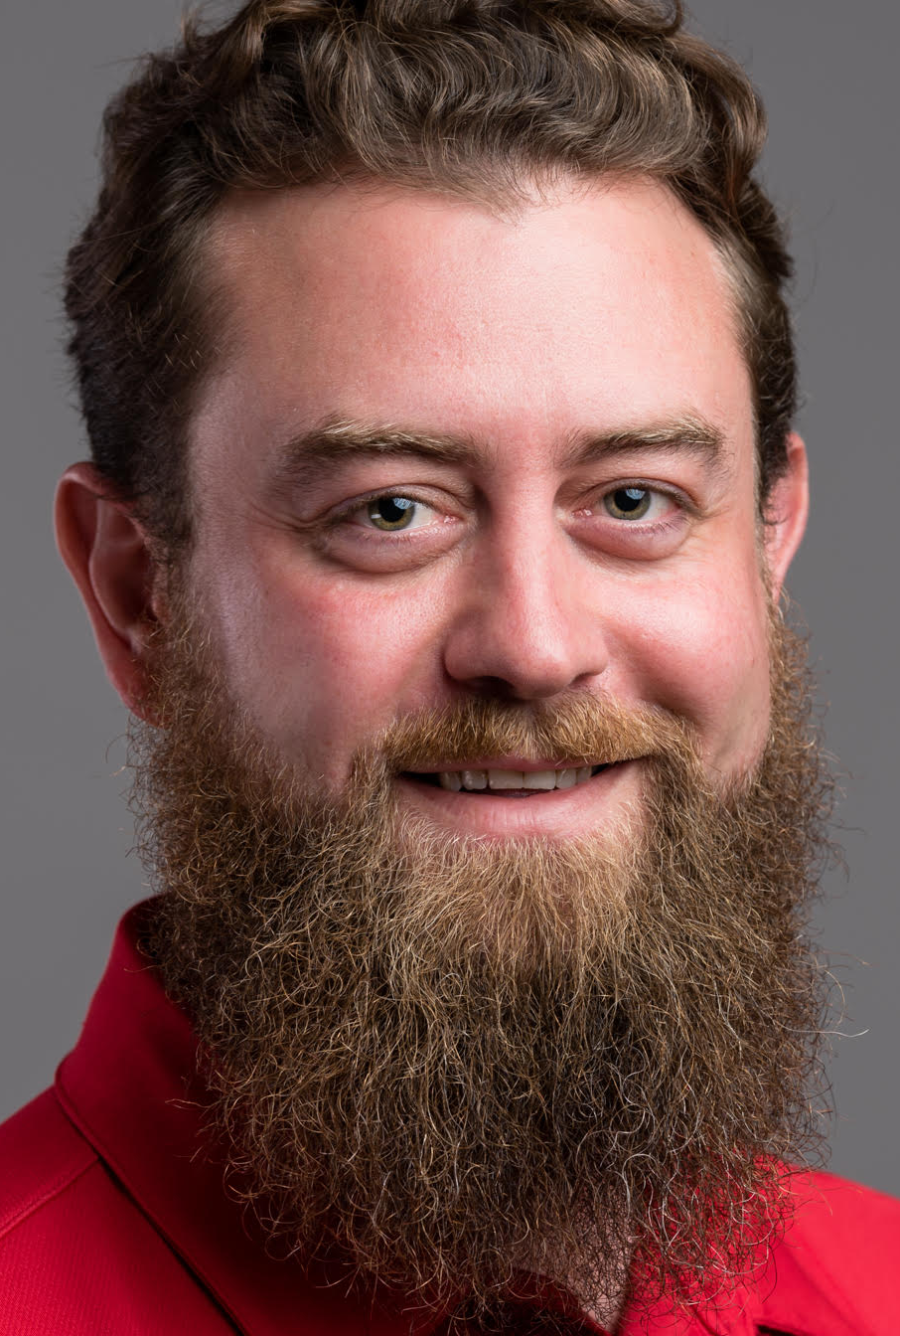
The Agile Fluency Model
Jason Knight
Sr. Scrum Master
MortgageNow
Jason Knight
Sr. Scrum Master
MortgageNow
How Agile Teams Typically Progress as They Develop New Capabilities
Notes:
Good afternoon! My name is Jason Knight, and I’m a Sr. Scrum Master working on the MortgageNow Scrum team. I’d like to introduce the Agile Fluency Model to you today. For those of you practicing Scrum, Kanban, or some other agile practices, doubtless you’ve wondered, “How well are we doing this?” and “Are we doing well enough?” and maybe, “How far to we want to progress as an agile team?” My goal is to offer the Agile Fluency Model to you as a way of answering those questions.

Slide 2
Disclaimers
“All models are wrong, but some models are useful.” – George Box
This talk is a “book report” and not an expert analysis.
Notes:
First, a couple disclaimers.
[animation]
As George Box has said, [read quote]. This is an imperfect model, but I hope you will find it useful.
[animation]
Second, I am not an expert in the AFM. I have learned just enough to report to you what I have found.

Slide 3
The AFM is not a Maturity Model
Maturity models usually:
Assume a particular framework or methodology
Must be combined with other maturity models in larger organizations
Assume a team’s goal is to achieve maximum maturity
AFM:
describes framework and methodology agnostic investments and benefits that should be expected in its Zones
can be used for any agile team seeking to improve and assess their agile fluency
describes a collection of choices; each zone represents a fully-mature choice. Each brings value.
Notes:
I must start by making an important distinction. The AFM is not a maturity model. It has characteristics which make it useful in different ways than maturity models are useful.
[animation]
Maturity models usually assume an agile team is using a particular framework or methodology like Scrum, Kanban or XP. Maturity models assess things like framework knowledge, process competence, and team culture. Therefore, larger organizations may find they need to use several maturity models to assess different teams with different practices.
[animation]
Importantly, maturity models usually assume that a team’s goal is to achieve maximum “maturity” as defined in the model
[animation]
In contrast, AFM defines zones of fluency that can apply to and assess any number of agile frameworks or methodologies. It follow then that it can be used by many teams, regardless of their chosen practices.
[animation]
Last, rather than assume a single, maturity destination, AFM assumes that each zone is a valuable destination, fully mature, and the right choice for some agile teams.

Slide 4
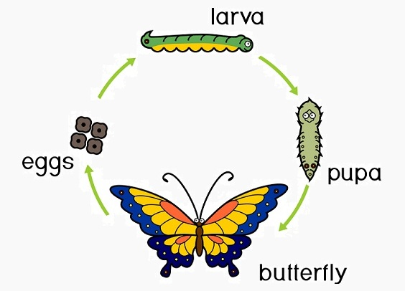
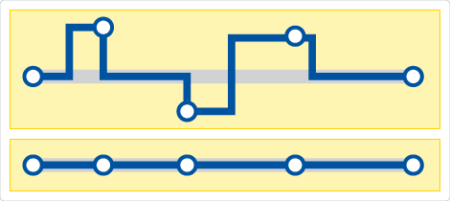
Fluency vs Maturity Models
Worse!
Better!
Valuable
Valuable
Notes:
Here’s an illustration of what I mean.
[animation]
For a butterfly, there is only one maturity destination that is the goal of every butterfly. They start as an egg, grow to a larva and mature through the pupa stage to an adult. Only then can they fly, pollinate flowers, and procreate.
[animation]
However, if I’m riding along a bus route, each destination may be a valuable choice given my intent. One day I may choose the 3rd stop where I’ll shop for groceries. The next day, I may choose the 5th stop to return my rented VHS tape to a local BlockBuster Video. If you get that reference, congratulations…you are officially a whippersnapper ;).

Slide 5
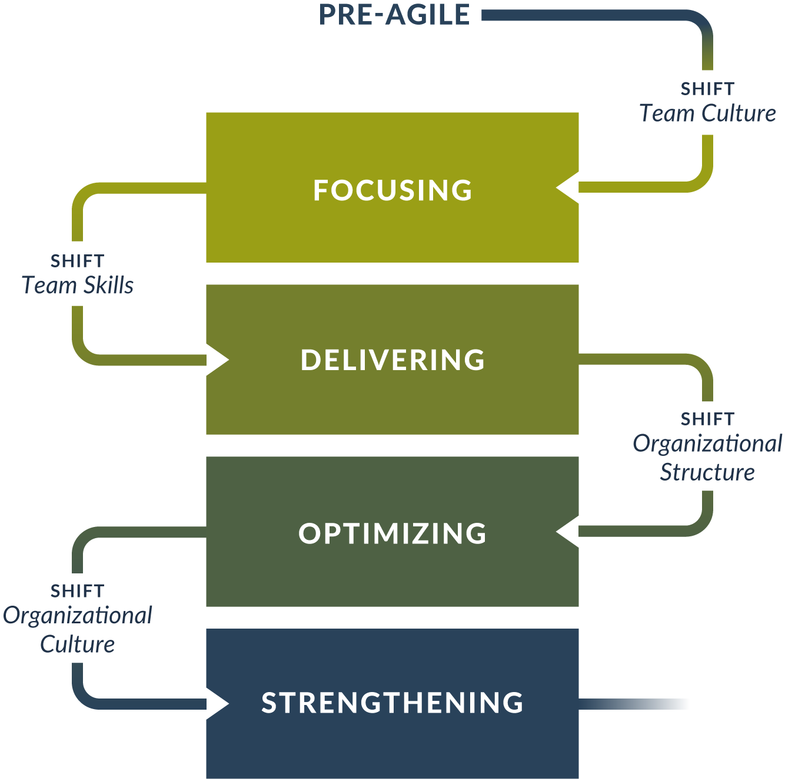
The Agile Fluency Model: Overview
Produce business value
Deliver on market cadence
Lead their market
Make their orgs stronger
Notes:
Here is an illustration of the 4 zones of fluency and how teams typically progress from one to another.
[animation]
The first zone is “Focusing” when teams grow in their ability to focus on and produce business value.
[animation]
The second zone is “Delivering.” Here, agile teams develop the practices necessary to deliver their business value on a market cadence
[animation]
The third zone is “Optimizing.” In this zone, an agile teams has so thoroughly understood their market, that they can deliver value that few others can or have even anticipated. They are leading their market.
[animation]
The fourth and final zone is “Strengthening.” Here, teams are poised to work actively in their organizations to encourage and equip deep, transformative change.
Let’s dive a little deeper into each of these zones.

Slide 6
“Focusing” Zone
“The team thinks and plans in terms of the benefits their sponsors, customers, and users will see from their product.”
Signs your team is in this “Zone”
Competency in fundamentals
Noticeable benefits to transparency and teamwork
Demonstrably better technology and team practices
Focus on valuable business results
Notes:
The focusing zone. In this zone, [read quote]
[animation]
You know your team is in this zone if they have competency in the fundamentals of their chosen framework or methodology. Scrum, Kanban and non-technical XP are such competencies.
[animation]
The team will notice significant benefits at this stage. Their work will be more transparent to both them and their stakeholders. They will collaborate more freely and effectively with one another.
[animation]
While they may not master needed technology (automated testing, continuous build, integration, and delivery pipelines), they will have demonstrated important success in implementing proofs of concept. They will also find success in team practices like: pair programming, code review, continuous improvement, and relationship-building.
[animation]
They will also show an ability to optimize the value of the work they produce and that is in their product. This requires some expression of the value their product brings.

Slide 7
“Delivering” Zone
“The team can release their latest work, at minimal risk and cost, whenever the business desires.”
Signs your team is in this “Zone”
Low Defects
High productivity
Responsive to business requests
Market boost by consistently delivering what market demands
Notes:
Next, the delivering zone. Here, [read quote]
[animation]
You will know your team is here when your work produces a low defect rate, short mean time to recovery, etc.
[animation]
Your productivity will be noticeably higher than it was when you were in the focusing zone.
[animation]
You will be very responsive to business requests. Imagine for example, receiving a request for a feature, refining it, developing and releasing it to production within a day or two.
[animation]
You will notice a significant boost in the market. Your markers for value e.g. revenue, market share, Gartner score, will be trending upwards.

Slide 8
“Optimizing” Zone
“The team understands what their market wants, what their business needs, and how to meet those needs.”
Signs your team is in this “Zone”
Innovative business agility
Pace-setters in their market
Respond to market disruption
Notes:
Third, the optimizing zone. In this zone, [read quote]
[animation]
Here your team produces truly innovative business agility. You know what your market wants, and have sophisticated tools and practices to deliver it. You may design experiments, use A/B testing, co-hort delivery, and rich telemetry dashboards that tell you quickly if your new feature is bringing the impact you expected.
[animation]
This sophistication allows you to begin to predict what your market will value, deliver it quickly, and set the pace for your competitors.
[animation]
Alternatively, these same practices allow you to respond quickly when your market is disrupted. This can come from a competitor’s surprise success e.g. Netflix, Uber, or AirBnB or from a drastic fluctuation e.g. Covid-19

Slide 9
“Strengthening” Zone
“The team understands its role in the larger organizational system and actively works to make that system more successful.”
Signs your team is in this “Zone”
Innovative management theory and practice
Cutting edge agile practices
Optimize organizational value streams
Notes:
The last zone, strengthening. Here, [read quote]
[animation]
In this zone, your team represents the future of agile practices, management theory, and culture. Examples of this might include Laloux’s “Teal organizational” altitude, Zappo’s Holacracy, or Google giving it’s worker’s 20% of their time to work on whatever project they want.
[animation]
You may invent new practices or technologies that allow you to leap forward. Past examples of this were things like Test Driven Development, Mob Programming, and Automated Deployment Pipelines.
[animation]
Last, you may participate in multi-team activities where you find ways to optimize the value-streams for other products that depend on you. You understand and can apply systems thinking and lean thinking to improve your organization as a whole.

Slide 10
“Organizational Fluency”
Fluency derives from teams, not organizations.
Organizations can enable or impede teams’ fluency
Management structures
Relationships
Organizational culture
And more…
Organizational investments are needed to support teams’ fluency
“Insufficient investment not only leads to slow progress, it creates lasting cynicism and resentment.”
Notes:
Now, a quick word about Organizational Fluency.
[animation]
According to the AFM, there is no such thing. Rather, fluency derives from teams and not the organizations in which they do their work.
[animation]
Certainly, organizations can affect teams’ agile fluency. Things like:
Management structures
Relationships
Organizational culture
And other such systemic conditions
…have direct and causal impacts that enable or impede.
[animation]
If teams are to progress optimally to their chosen zone of fluency, it is critical that the organization provided the necessary support and investments. Failure to do so will produce slow progress at best and lasting cynicism and resentment at worst.

Slide 11
Losing Fluency?
Rare; usually external disruption
New management removing support
Turnover
Rapid growth; imposed bureaucracy or some scaling frameworks
Better scaling frameworks
Nexus from Scrum.org
Large Scale Scrum (LeSS) from Craig Larman and Bass Vode
Notes:
Once gained, will a team lose their agile fluency?
[animation]
This is a rare occurrence. When it happens, it is often the result of disruptions outside the team.
[animation]
For example, new management may decide that “Agile” is just a buzzword, and pull their support for a team’s practices.
[animation]
A team may lose too many, key individuals and be unable to sustain their practices.
[animation]
In the case of rapid growth, an organization may impose arbitrary bureaucracy on agile teams which limit their agility in detrimental ways. One form of this would be to impose an overly prescriptive scaling framework. Rather than increase teams’ ability to work together with agility, this has the effect of limiting self-organization, cross-functionality, product ownership authority, or other fundamental responsibilities crucial to an agile team’s success.
[animation]
The Nexus and Large Scale Scrum scaling frameworks are constructed specifically to avoid these bureaucratic impositions.

Slide 12
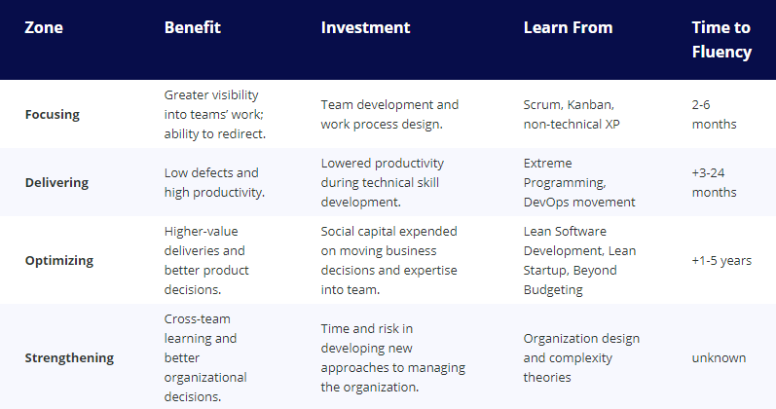
Benefits, Investments, Learning and Time
Notes:
According to the AFM authors, time to fluency varies from team to team.
[animation]
Time for a beginning team to reach Focusing fluency is 2-6 months
[animation]
For delivering fluency, it’s an additional 3-24 months
[animation]
For optimizing fluency, another 1-5 years
[animation]
For strengthening fluency, the time is less certain and therefore cannot yet be listed.

Slide 13
Conclusion
AFM is not a maturity model
Agile teams progress in typical ways
AFM groups this progression into 4 “zones of fluency”
Focusing, Delivering, Optimizing, Strengthening
Each zone provides benefits and is the right destination for some teams
Teams need time and organizational support to become more fluent
Teams rarely lose fluency except when external influences disrupt teams’ practices
Notes:
To sum up, the AFM is not a maturity model.
[animation]
It holds that agile teams progress in predictable ways
[animation]
They progress into four, distinct “zones of fluency”
- Focusing, Delivering, Optimizing, and Strengthening
[animation]
Each zone brings value and is the right destination for some teams
[animation]
Each team will need time and organization support to become more fluent in agility
[animation]
Teams rarely lose the fluency they gain unless disrupted by external influences.

Slide 14
References and Further Reading
AFM additional reading
Brief video summary by the authors
The Agile Fluency Overview
The Agile Fluency eBook
Systems Thinking, Agile Leadership, and Lean Thinking reading
Reinventing Organizations – Frederick Laloux
Toyota by Toyota – Sammy Obara, Darril Wilburn
The Goal – Goldratt, Cox
Evolvagility – Michael Hamman
From Project to Product – Mik Kersten
Notes:
If you would like to dig deeper into the AFM, please use these three links as a starting point. I’ve also included several other links to reading that will help you if you are interested in systems thinking, agile leadership, and lean thinking. You can access them all in the PDF of this presentation which we will post to our CoP library after this meeting concludes.
AFM reading
https://www.youtube.com/watch?v=qvvMl1F_Tow
https://www.agilefluency.org/model.php
https://martinfowler.com/articles/agileFluency.html
Systems Thinking, Agile Leadership, and Lean Thinking reading
https://reinventingorganizationswiki.com/Main_Page
https://www.amazon.com/Toyota-Reflections-Techniques-Revolutionized-Industry/dp/1439880751
https://www.amazon.com/Goal-Process-Ongoing-Improvement/dp/0884271951/ref=sr_1_2?crid=17JKPQQ9DSIV6&dchild=1&keywords=the+goal+goldratt&qid=1606855571&s=books&sprefix=the+goal+gol%2Cstripbooks%2C233&sr=1-2
https://www.amazon.com/Evolvagility-Growing-Leadership-Culture-Inside-ebook/dp/B07L2HDYP2/ref=sr_1_1?dchild=1&keywords=evolvagility&qid=1606855741&s=books&sr=1-1
https://www.amazon.com/Project-Product-Survive-Disruption-Framework/dp/1942788398/ref=sr_1_1?crid=1HNH7TLGT8A4R&dchild=1&keywords=project+to+product+mik+kersten&qid=1606855669&s=books&sprefix=project+to+product%2Cstripbooks%2C221&sr=1-1

Slide 15
Thank you!
Notes:
That’s all folks. Thank you for listening!

